Slide 1
Unit 10: Industrial Revolution introduction

Slide 2
Unit 10: New Global Age
02/27/2018
Announcements:
3rd quarter closes March 14
Testing this week (makeups)
and next week (yay)
Spring Break: march 26-30
Extra Credit:
What: Saturday Academy
9th/10th grade FSA Writing Workshop
When: 8:00-12:00 lunch provided
Where: Main Media Center
Make sure you sign in to get your extra credit!
Materials:
Industrial Revolution Notes
Sheet
Agenda:
Silent Reading (it’s back!)
Unit 10: Industrial Revolution Introduction Guided Notes

Slide 3
1) Do you make your clothes?
2) Do you buy your clothes?
3) Where from?
4) Where do those places get the clothes?

Slide 4
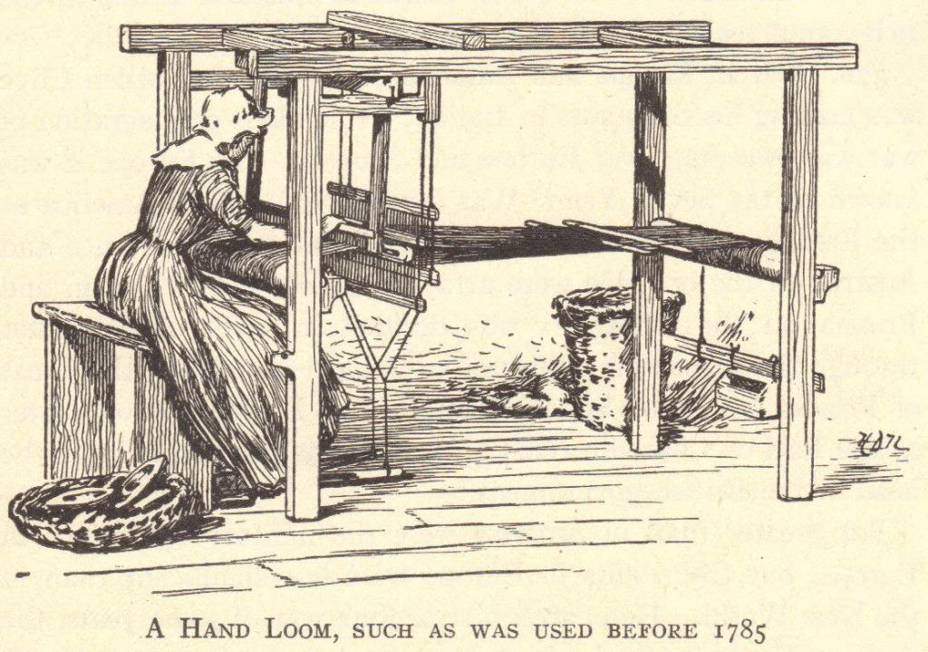
Unit 10: Defining industrial revolution
Industrial – Having to do with industry, business or manufacturing.
Revolution – a huge change or a change in the way things are done.
Industrial Revolution – a change from making things by hand to making them in factories.

Slide 5
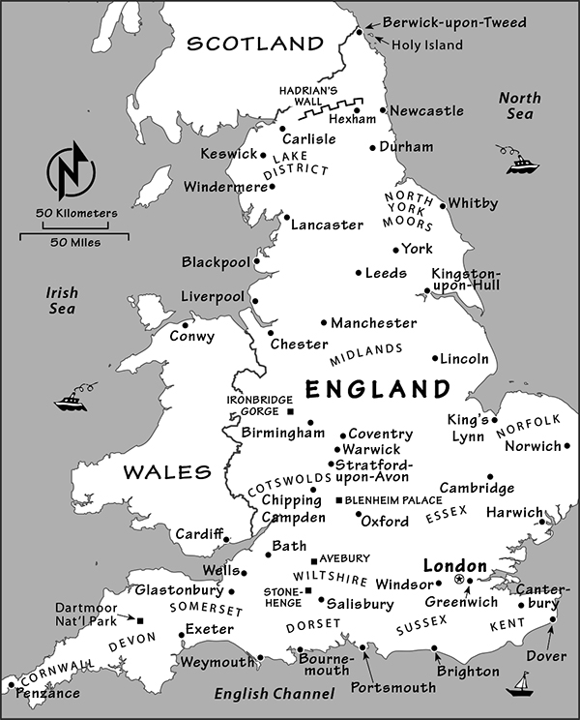
Defining “Industrial Revolution”
The first Industrial Revolution began in England in the late 18th century.
An industrial revolution is when hand tools are replaced by factory machines, and farming is replaced by large-scale manufacturing.
Example: the making of clothes.

Slide 6
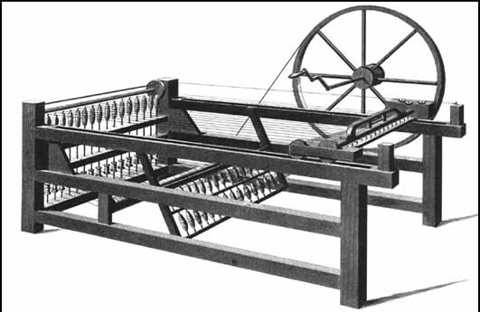
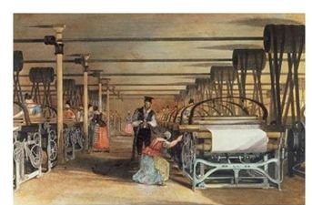
Example: Making Clothing
Before
Clothes were made at home
After
Clothes were made by machines in factories

Slide 7
Background for the industrial revolution
Scientific Revolution
17th and 18th centuries
Discoveries of Copernicus, Newton, etc.
The Enlightenment: Intellectual Revolution
17th and 18th centuries
Writings of Locke, Voltaire, etc.
Atmosphere of discovery
Greater knowledge of the world
Encouraged learning and the search for better and newer ways of doing things

Slide 8
Why England?
Capital ($) for investing in the means of production
Colonies and Markets for manufactured goods
Raw materials for production
Workers
Merchant marine
Geography

Slide 9
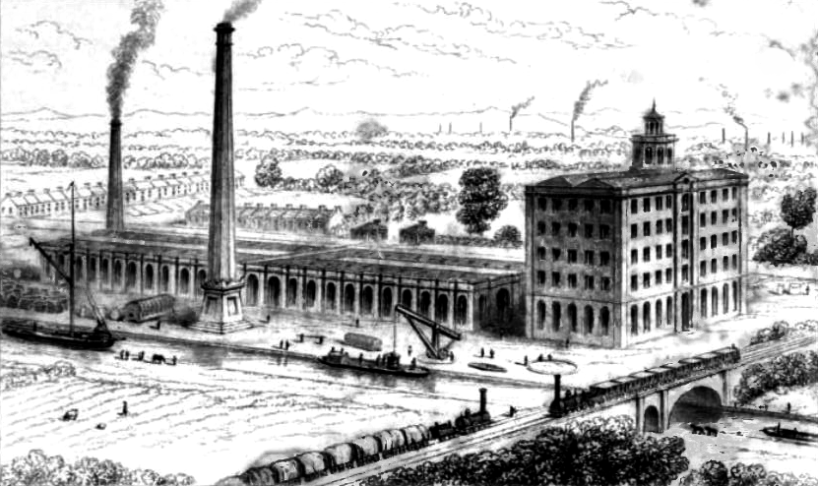
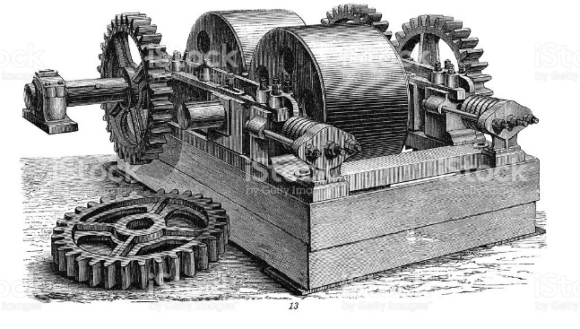
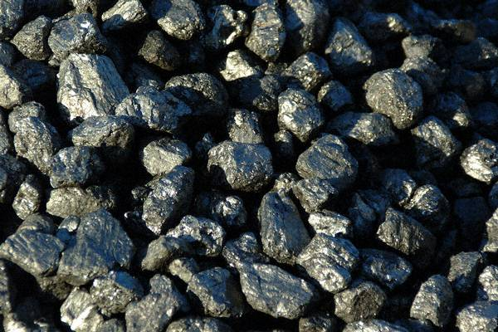
Why England: Capital ($)
The Commercial Revolution made many English merchants very wealthy
These merchants had the capital ($) to invest in the factory system – money to buy…
buildings,
machinery,
raw materials.
Illustration of a factory.
Grinding machine.
Coal.

Slide 10
Why England: colonies & markets
Wealth spread beyond the merchant class
England had more colonies than any other nation
Its colonies gave England access to enormous markets and vast amounts of raw materials

Slide 11
Why England: raw materials
England had the materials it needed!
Coal – vast coal reserves powered steam engines
<- this is a steam engine locomotive, by the way!
Iron – basic building block of large machines, railroad tracks, trains, and ships

Slide 12
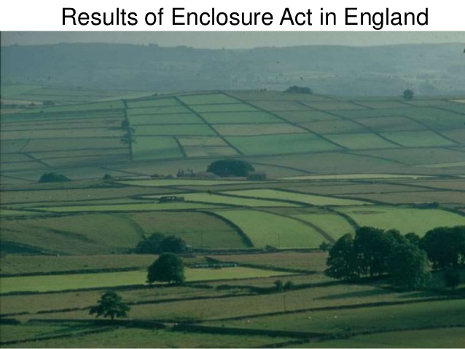
Why England: workers
English people could freely travel from the countryside to the cities
Enclosure Acts – caused many small farmers to lose their lands, and these former farmers increased the labor supply (they had to find work somewhere!)
What do you see?

Slide 13
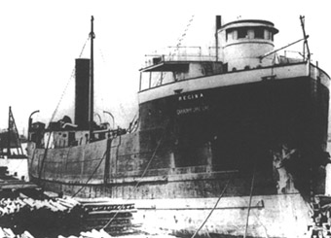
Why England: merchant marine
World’s largest merchant fleet
Vast numbers of ships could bring raw materials and finished goods to and from England’s colonies as well as trade with other countries

Slide 14
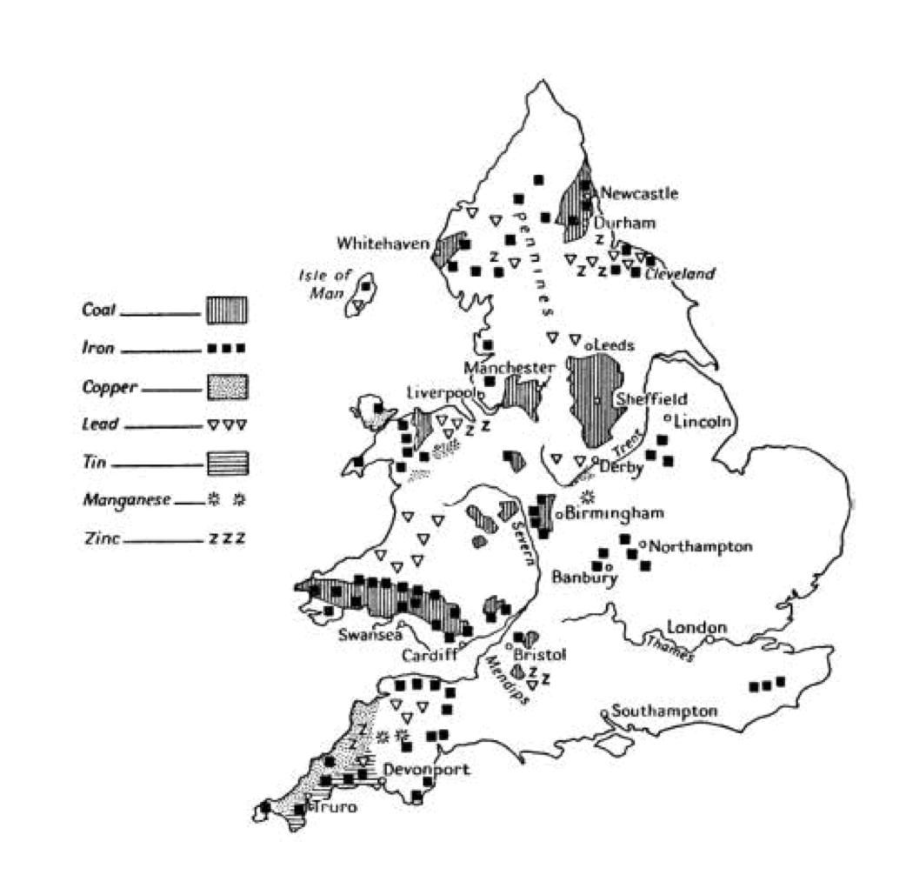
Why England: geography
England is the political center of Great Britain, an island
Great Britain (as the entire island was called beginning in 1707) did not suffer fighting on its land during the wars of the 18th century
Island has excellent harbors and ports
Damp climate benefited the textile industry (thread did not dry out)
Government was stable
No internal trade barriers

Slide 15
Why England? Why the USA?
The industrial revolution began in England but came over to the United States, too. The USA had a lot in common with the conditions in England and rose to being an industrial superpower in the market.
On the bottom of your paper:
Do any of the six reasons apply to the USA? How? Think of the resources in the USA!

