Slide 1
Unit 10: inventions of the industrial revolution

Slide 2
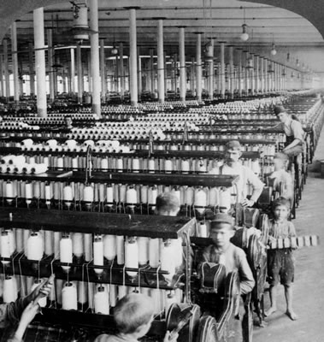
Inventions: thread spinning mill
Builder: Samuel Slater
Year: 1789
Function: Produced cotton thread
Effect: Rapid rate of production

Slide 3
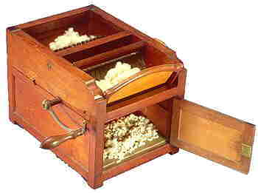
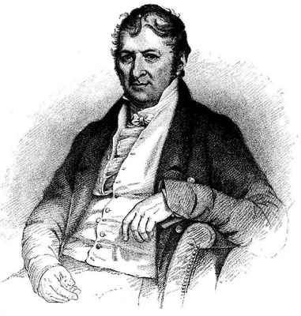
Inventions: cotton gin
Inventor: Eli Whitney
Year: 1794
Need for cotton by factories in the North
Function: A worker could produce fifty time more cotton fiber
Effects:
Increase of slave labor
“Cotton Kingdom:” owners of large plantations

Slide 4
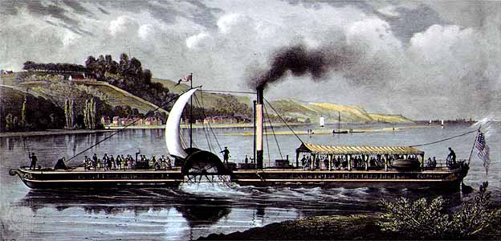
Inventions: steamboat
Builder: Robert Fulton
Year: 1807
First practical steamboat was called the Clermont
Function: Used for trade and the moving of raw materials
Effect: Made traveling on river easier and faster
First oceangoing steamship wouldn’t be produced until 1850 in Great Britain

Slide 5
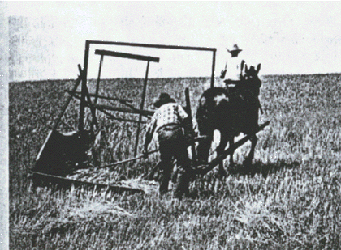
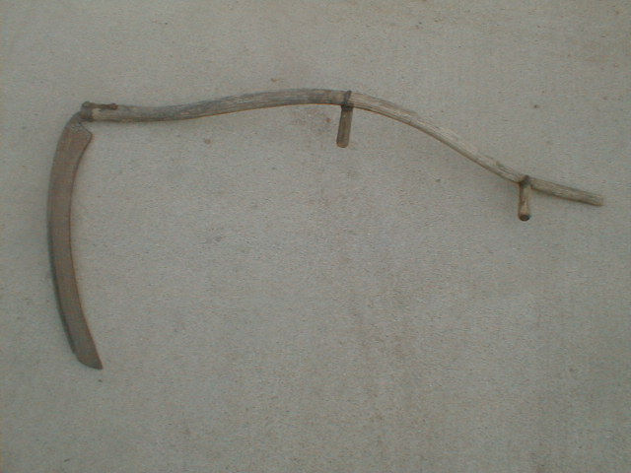
Inventions: mechanical reaper
Inventor: Cyrus McCormick
Year: 1831
Function: Cut wheat many times faster than a human worker could
Effect: Enabled farmers to cultivate more land with fewer workers
Great for the prairies of the Midwest

Slide 6
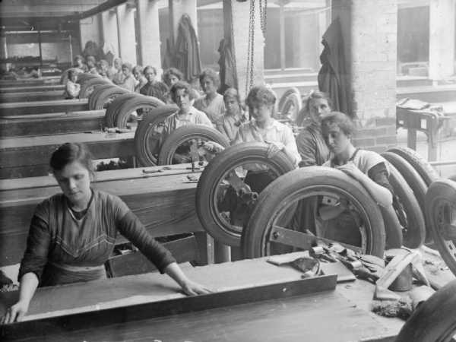
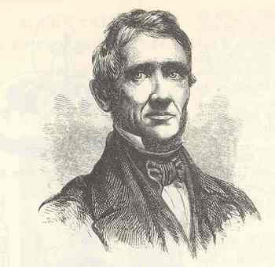
Inventions: vulcanized rubber
Inventor: Charles Goodyear
Year: 1839
Function: Made working with rubber easier
Removed sulfur and then heated so it would retained its elasticity
Enabled rubber to be used in machine parts to seal gaps (important for steam engines!) and eventually tires.
Effects: Improved efficiency/durability of engines

Slide 7
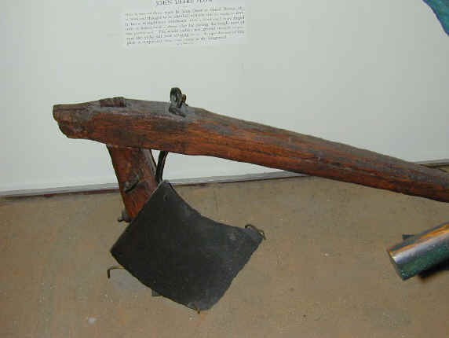
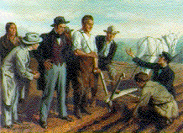
Inventions: Steel plow
Inventor: John Deere
Year: 1837
Tough plains soil could not be plowed by cast iron plows (soil sticking; very difficult to plow and took a lot of time!)
Function: Assisted farmers greatly
Effect: Durable, effective, faster plowing for agriculture in the USA

Slide 8
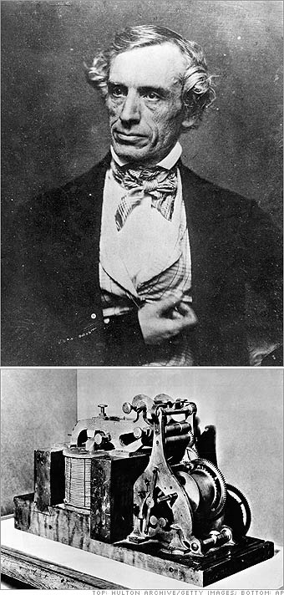
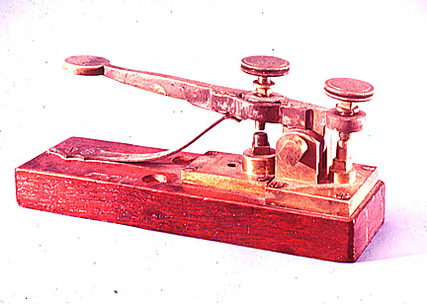
Inventions: telegraph
Inventor: Samuel Morse
Year: 1844
Function: Sending messages long-distance, instantly, using Morse Code
Effects:
Revolutionized communication
Factories in the East could now communicate with markets in the West

Slide 9
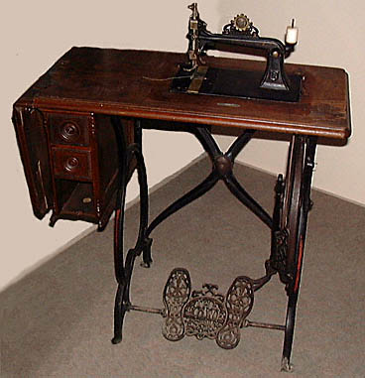
Inventions: sewing machine
Inventor: Elias Howe
Year: 1846
Function: Made producing clothing efficient (no more hand sewing)
Effect: Made clothes less expensive so even the lower and middle classes could dress like the wealthier Americans

Slide 10
Inventions: which had the greatest impact?
Go back and rank the inventions 1-8.
“1” = most important
“8” = least important
Answer the question on the bottom:
Why did you rank the inventions the way you did? Explain why you picked your “1” and “8”.

