Slide 1
The Industrial Revolution
02/26/2019
World History: Unit 10
The Urbanization Game
If you have played this, don’t spoil it for anyone!
Setting up before the bell:
Get a piece of copy paper from the box and a pen
Clear everything else off of your desk: no phones/headphones

Slide 2
An English Rural Village, 1700 C.E.
Draw the following:
River going West to East
1 inch wide
Bridge crossing the river
A lot of trees!
like 20
4 Roads going in each direction
1 Store to buy goods that cannot be produced at home
10 Houses
same size
1 Church
Commons Area
3x3 inches
1 Coal Mine
1 Cemetery
Example ^

Slide 3
The Industrial Revolution Part II - Urbanization
Over the next 100 years, a revolution will completely change life in your village.
Some historians believe this revolution is the most fundamental change in human history.
You will experience some of these changes as your village shifts toward an industrialized economy.

Slide 4
It is now 1745 C.E…
England’s geography is unique in that no section of the country is more than 90 miles from the Atlantic Ocean or North Sea, and there are many navigable rivers that crisscross the countryside.
Other factors of production give England an advantage:
Natural resources: coal, iron & timber
Agricultural productivity: Enclosure Acts
Gov’t Encouragement: Legal protection of private property & Entrepreneurial spirit
Free market capitalism: accumulates $$$

Slide 5
Round 1: 1745 C.E. An enterprising young capitalist decides to invest money in the construction of the canal. This will allow for more efficient and cheaper shipping of goods and the profits are astonishing!
Draw:
1 canal that runs PARALLEL to the river
1 nice home ANYWHERE in the village. This your home ☺

Slide 6
Early Canals

Slide 7
Round 2: 1750 C.E. For a variety of different reasons (soap, diet, sanitation, etc…) there is a population explosion in England and in your village. Many diseases that have killed villagers have been virtually eliminated due to the disposal of sewage in the canals and then ultimately the ocean.
Draw
5 houses

Slide 8
Round 3: 1760 C.E. The people of your village need a bit more food and goods to meet the needs of the new inhabitants. New farming technology—SEED DRILL & THRESHING MACHINE—causes an increase in farm production. As a result, people need more land to increase productivity. Parliament will pass the Enclosure Acts, in which the government will take land from the Commons to sell to local farmers.
Eliminate ½ of your Common Lands
Draw
1 nice house

Slide 9
Enclosure Acts

Slide 10
Round 4: 1773 C.E. A man named Richard Arkwright invents a new machine called the Water Frame can spin and weave cloth a hundred times faster than could be done by hand in a farm cottage. The old way (Cottage Industry) required a family to spin and weave the cloth by hand inside their cottage…Labor is now concentrated in a single location and becomes more specialized over time. Remember, the cotton factory must be placed on the river bank, because canal water is not swift enough to generate the power to move the parts of the water frame.
Draw
1 Factory along the RIVERBANK
DO NOT add smoke to this factory!

Slide 11
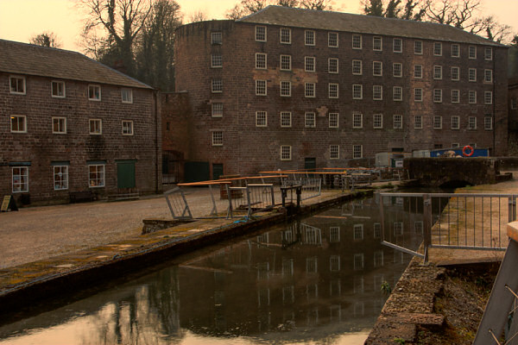
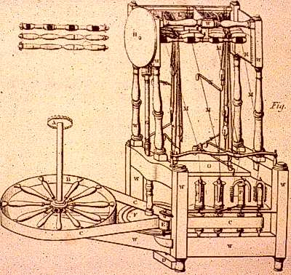
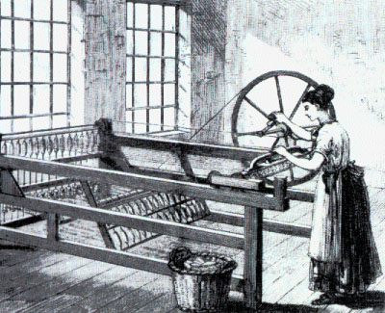
Factories & New Inventions

Slide 12
Round 5:1774 C.E.
Workers are needed to work in this new factory.
Many people (mainly women) cannot compete with the efficiency of the factory AND there are a large number of poor families who have lost their livelihood due to the Enclosure Acts→ we have an available supply of workers.
Also many people hear about the factory and move to your village to find work.
Draw
5 houses
1 church
1 store
Additional roads may be built
1 additional bridge may be built
STORE

Slide 13
Round 6:1780 C.E. Unemployed workers from surrounding areas flood into your community looking for work; even though wages are very low, they look attractive to starving families. Housing is in great demand and for the first time a new kind of housing is constructed called Tenements. Often a family and their extended family members lived within 2-3 rooms…Typically 10-13 families lived on the same floor. Each floor had 1 communal bathroom, if the building was nice. Sometimes it was 1 bathroom for every 2 floors.
Draw
5 tenement homes

Slide 14
Industrial Living Conditions

Slide 15
Round 8:1785 C.E.
A man named James Watt invents a new machine called the steam engine.
The steam engine replaces the water frame.
It is far more efficient.
It allows factories to be built away from the river.
This source of power is more mobile.
Capitalists quickly replace their water frames with steam powered weaving and spinning machines.
The main business in England is still textile manufacturing and those owners are making more money than ever!
Draw
10 factories WITH smoke
ADD smoke to all old factories
1 nice house

Slide 17
Steam Engine

Slide 18
Round 9:1815 C.E.
There is a great demand for coal
Home-heating, fuel for the steam engines, for the production of iron.
Although in the 1700’s coal miners were adults who worked in the winter to supplement their wages, in the 1800’s they are typically children between the ages of 8 and 14.
The work is dangerous and unhealthy.
Children become victims of black lung, explosions, & accidents.
Their growth is stunted as they spend their 14 hour day stooped over.
They are malnourished and unable to exercise or eat properly.
Casualty rates go up.
Draw
1 cemetery
RIP

Slide 19
Working Conditions

Slide 21
Round 10:1820 C.E.
It is 1820—Five Years Later
The existing canals and dirt roads cannot accommodate the heavy industrial traffic.
New experiments with transportation using the power of a steam engine are tried.
The most successful appears to be a steam engine that pulls a series of wagons or cars on an iron track.
The first railroad is tested and proves to be quite effective.
Draw
1 major Railroad line
Connect your factory district to your coal mining regions!

Slide 22
Steam Engine

Slide 23
“The Great Land Serpent”

Slide 24
Round 11:1827 C.E.
This new “revolution” in transportation draws thousands of people to your community.
Soon there becomes a surplus of workers.
Capitalists who wish to ensure their profits decide to hire women and children over men
They will perform the same factory labor at one-half to one-quarter the price.
More and more children leave their homes to work.
Men, many of whom are depressed, ashamed, and angry about their wives, and children toiling in factories (this went against common family values of the time) turn to crime and the social life of the pub.
Family life that existed for hundreds of years in England is disrupted.
Family members seldom eat together or see each other.
For the first time in England’s history, alcoholism appears in epidemic proportions.
Draw
1 jail

Slide 25
Round 12: 1828 C.E.
Eleven Years Later
The two predominant factories are textile and iron (steel).
Working conditions in either of these two were appalling.
Many workers contacted the deadly factory fever or white lung disease.
It was probably a variety of lung ailments: cancer, tuberculosis, emphysema, ect…
Other workers were injured on the job in factory accidents.
There were no protective railings around huge moving mechanical parts of machinery.
Children, weakened from lack of proper sleep or diet, stumbled into machinery and were mutilated.
Women with long hair could be undone and was often caught in moving machinery.
Regardless, if you were unable to work, you were fired.
There was no health insurance.
There was always a daily line of unemployed workers waiting to fill vacant jobs.
Draw
2 hospitals
1 cemetery
RIP

Slide 26
Round 13: 1840 C.E.
Two years later
The need for quicker transportation grows.
Coal, iron, finished products, & raw materials must all be transported from one area of England to another.
The ‘Second Industrial Revolution’ led to new methods in the production of steel, chemicals, electricity & precision machinery!
Draw
1 Railroad line
3 Factories w/ smoke

Slide 27
Round 14: 1850 C.E.
Ten Years Later
By this year several million acres of good English land has been enclosed and sold to private parties of large estates.
Despite the misery this creates for England’s landless poor, the economy benefits for the rich are obvious.
These farmers purchase the newest power-driven machinery and can easily feed the working class of England (including the Irish).
The small landowning farmer is crushed by the enclosed commons.
They cannot afford the machinery and therefore cannot compete and grow food profitably.
Thousands of these people leave their villages (where their ancestors had lived for hundreds of years) and move to towns and cities looking for work to feed their families.
Some refused to leave but took jobs working for the large landowning farmers.
By the thousands, they moved to the bleak, uninviting towns of the north in the new cotton mills.
Draw
15 houses
3 tenements
2 stores
1 church
3 factories
1 nice house
STORE

Slide 28
England City, 1850

Slide 29
Reflection
Compare and Contrast life in your rural town to life in your industrialized city.
What were living conditions like and how did they change?
What might happen as a result of the above change / how might the people react / what would they want?
What were working conditions like and how did they change?
What might happen as a result of the above change / how might the people react / what would they want?
If you could reorganize and plan out your city, what would you change? Why?

