Slide 1
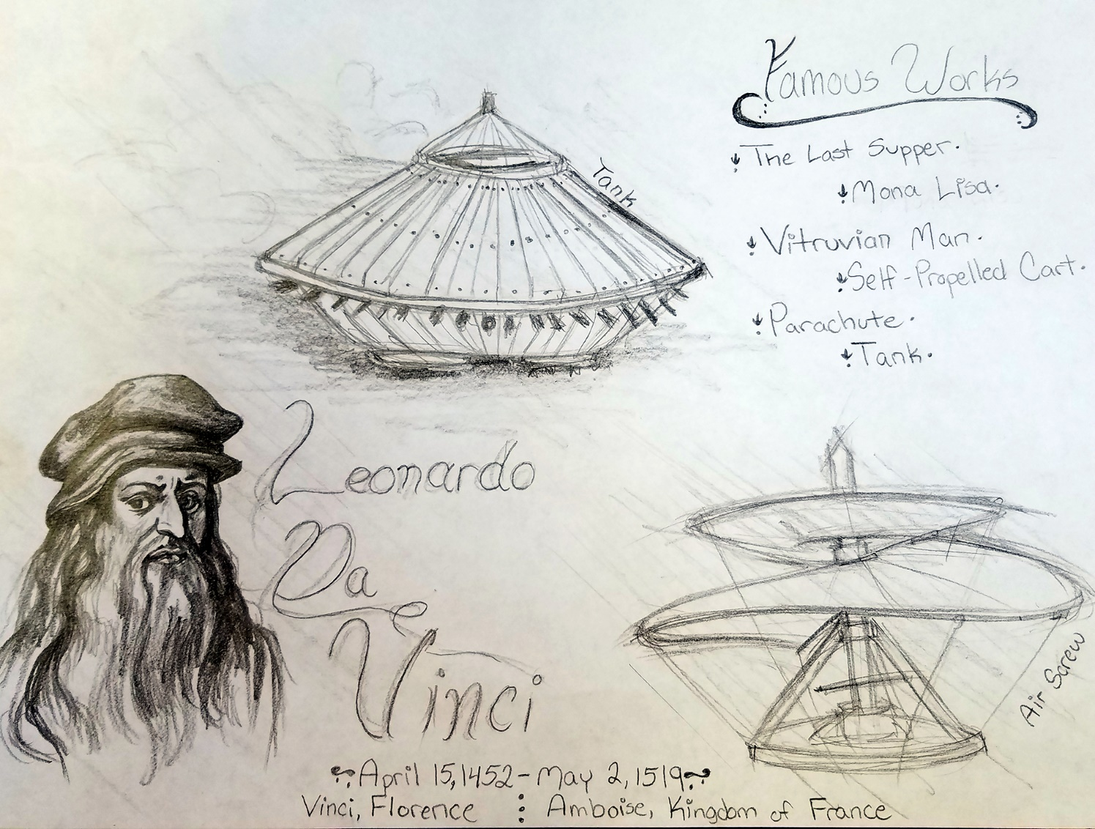
Unit 5: Renaissance and Scientific Revolution
Hypothesis
Geocentric
Heliocentric
Leonardo da Vinci
Michelangelo
Copernicus
Galileo
Francis Bacon
Scientific Method
Isaac Newton
Heresy
Secular
Shakespeare
Gutenberg (Printing Press)
Raphael
Machiavelli (The Prince)
Perspective
Select 5 of the following words and create an informational mini-poster:
This is an example for Leonardo da Vinci ^

