Slide 1
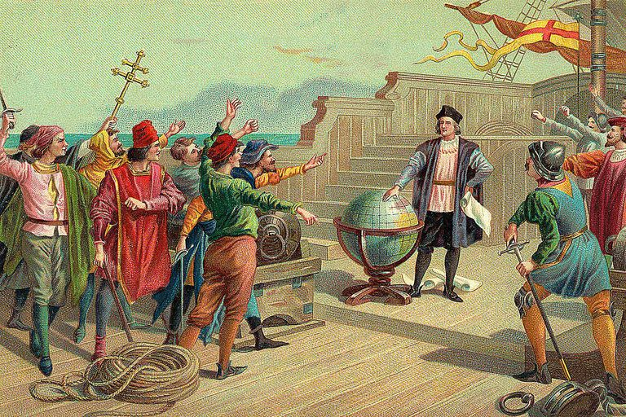
What was the “age of Exploration”?
Started15th century and lasted through the 17th century (same time as the Renaissance and Reformation, generally)
Europeans began exploring the world by sea in search of new trading routes, wealth, and knowledge
What caused Age of Exploration?

Slide 2
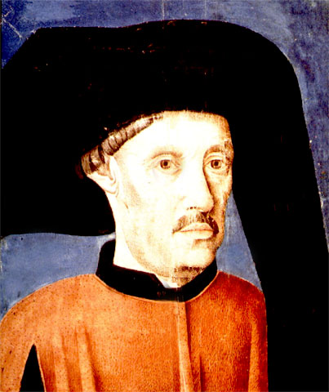
How did it all begin?
The first to encourage new ship explorations was Prince Henry of Portugal, known as “Prince Henry the Navigator”
Started an institute for seafaring and exploring
Combined ship technology learned from Islam with new European innovations

Slide 3
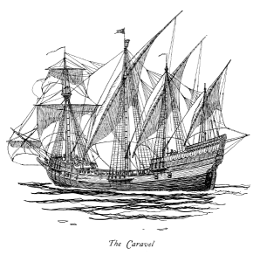
Why didn’t people voyage that far before?
They didn’t have the technology until a ship called the caravel was invented
It was faster, floated higher in the water (to explore more rivers), and could steer better than older ships
Compass, astrolabe, maps and other technologies from Islamic culture all helped make explorations possible

Slide 4
Causes of the age of exploration: the 3 g’s
Religious Enthusiasm: GOD
Missionaries from Spain and Portugal sought to spread Christian religion.
Desire for Profits: GOLD
Capitalist economy was just emerging and people were seeing new wealth from investment and trade.
Emergence of Powerful European Rulers: GLORY
Wanted to extend their influence and find fame through exploration.

Slide 5
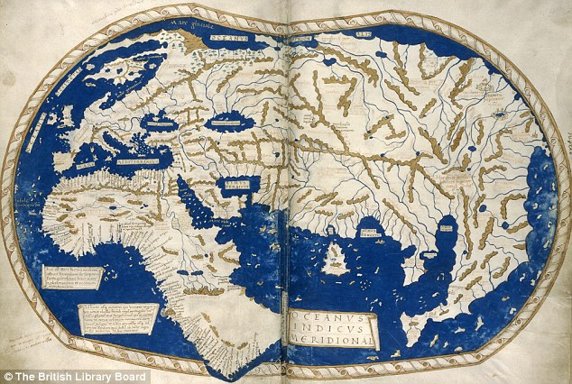

Slide 6
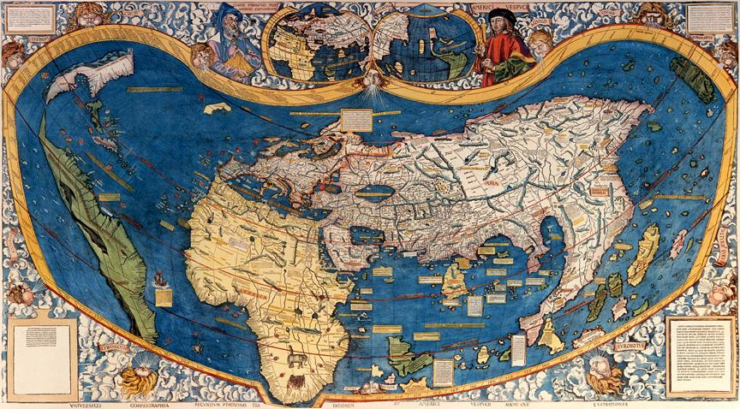

Slide 7
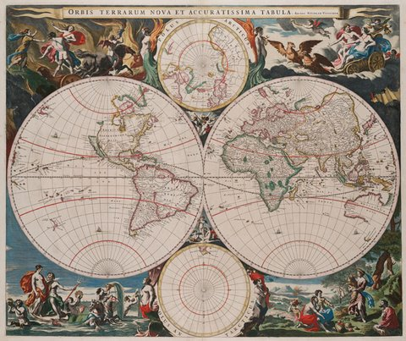

Slide 8
Who led these voyages?
Many explorers were sponsored by Kings and Queens from different countries.
Q: What is a sponsor?

Slide 9
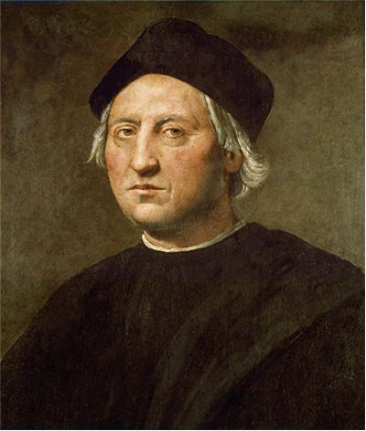
Researching the voyagers
Complete your little boat organizer for the following:
Christopher Columbus (1492)
Juan Ponce De Leon (1513)
Hernan Cortes (1519)
Francisco Pizarro (1528)
Ferdinand Magellan (1519-1522)
Vasco de Gama (1497-1499)

